Slide 1
October 28, 2025

Slide 2
South Resiliency Water Treatment Plant Project
KC Water - Engineering & Facilities
October 28, 2025

Slide 3
Agenda
KC Water – Engineering & Facilities
Project overview and background
Project drivers, goals, and benefits
Review of potential sites
Screening criteria review
Recommend site
Funding discussion
Next steps

Slide 4
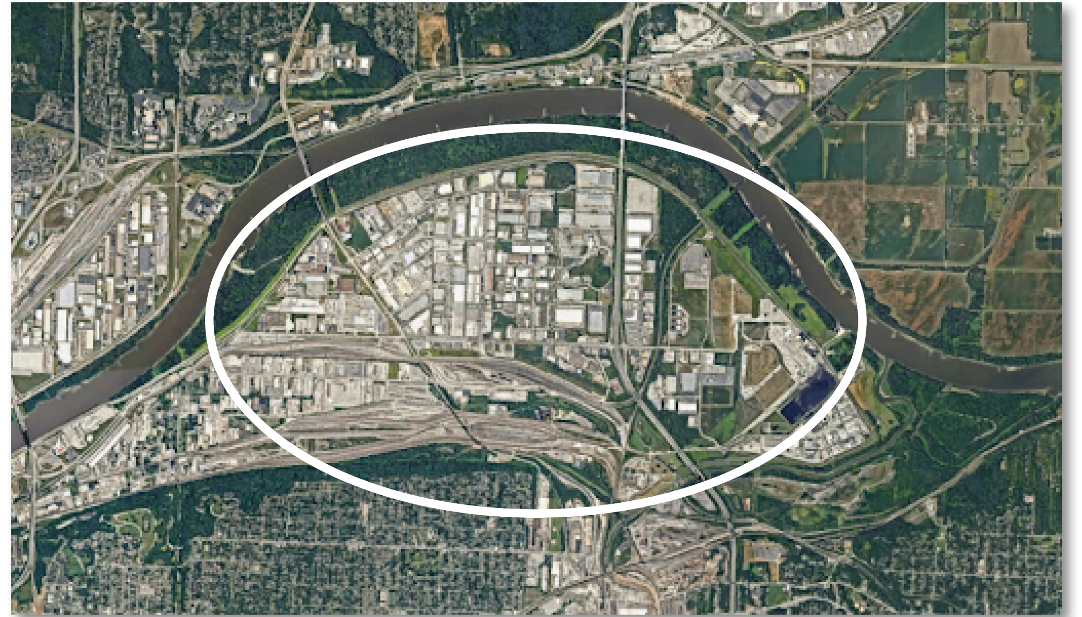
Project Overview
KC Water – Engineering & Facilities
KC Water is currently evaluating potential sites for a future water treatment facility in and around the East Bottoms area in Kansas City, Missouri.

Slide 5
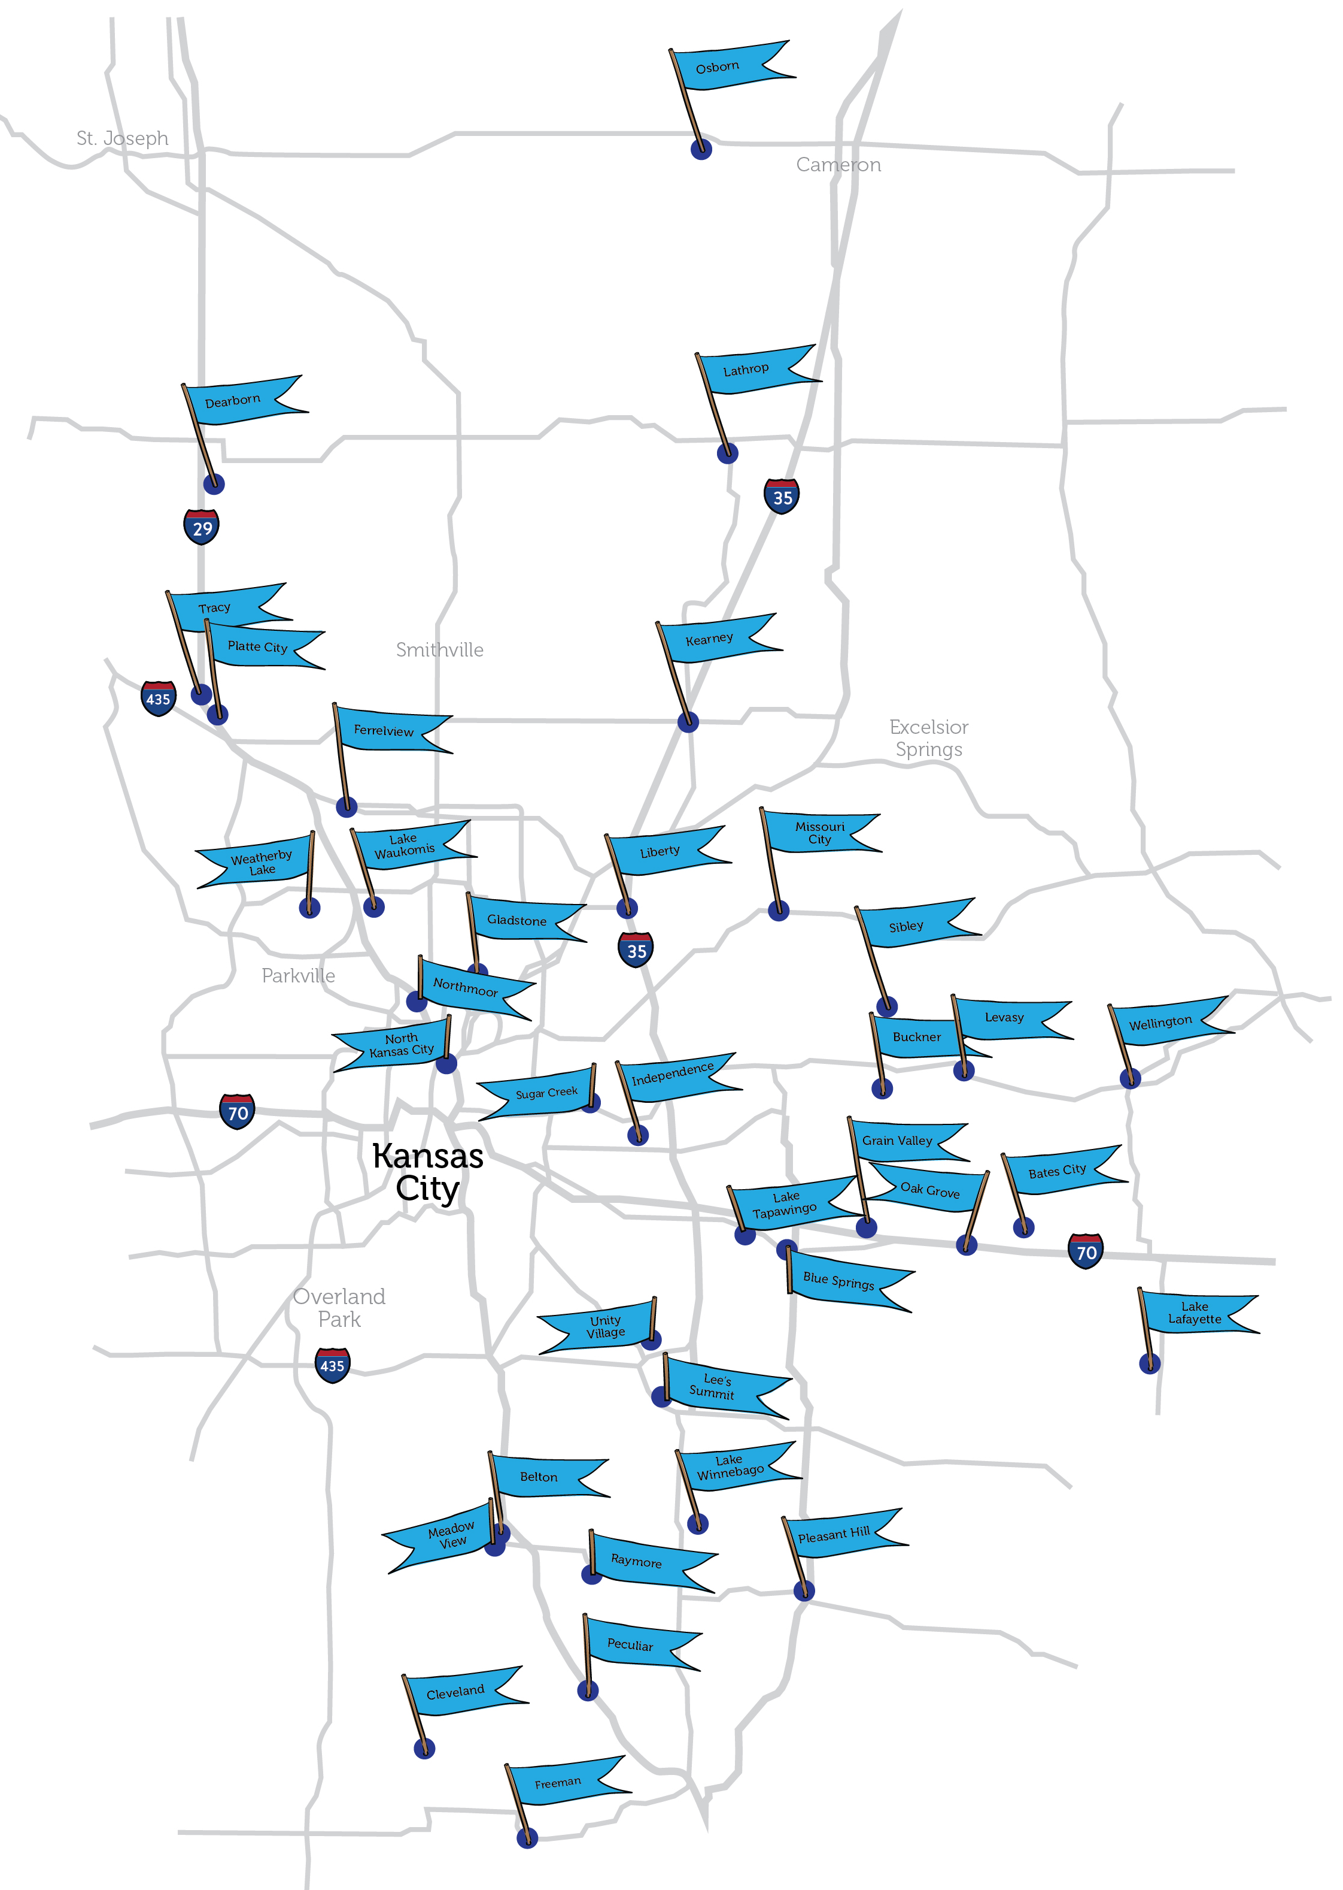
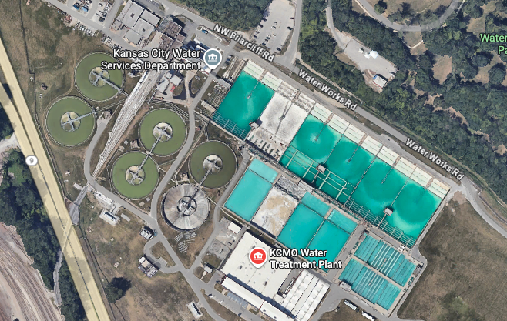
Briarcliff Water Treatment Plant
KC Water – Engineering & Facilities
Located north of the Missouri River, west of N. Oak Trafficway and east of Highway 9
Built in 1920
Treats approximately 100 million gallons per day
Pulls 80% of the water from the Missouri River and 20% from ground water sources (wells)
Delivered to nearly 1 million people across 89 municipalities and wholesale customers

Slide 6
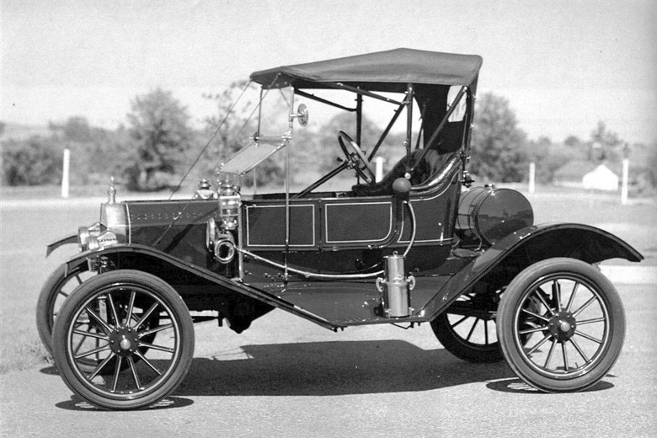
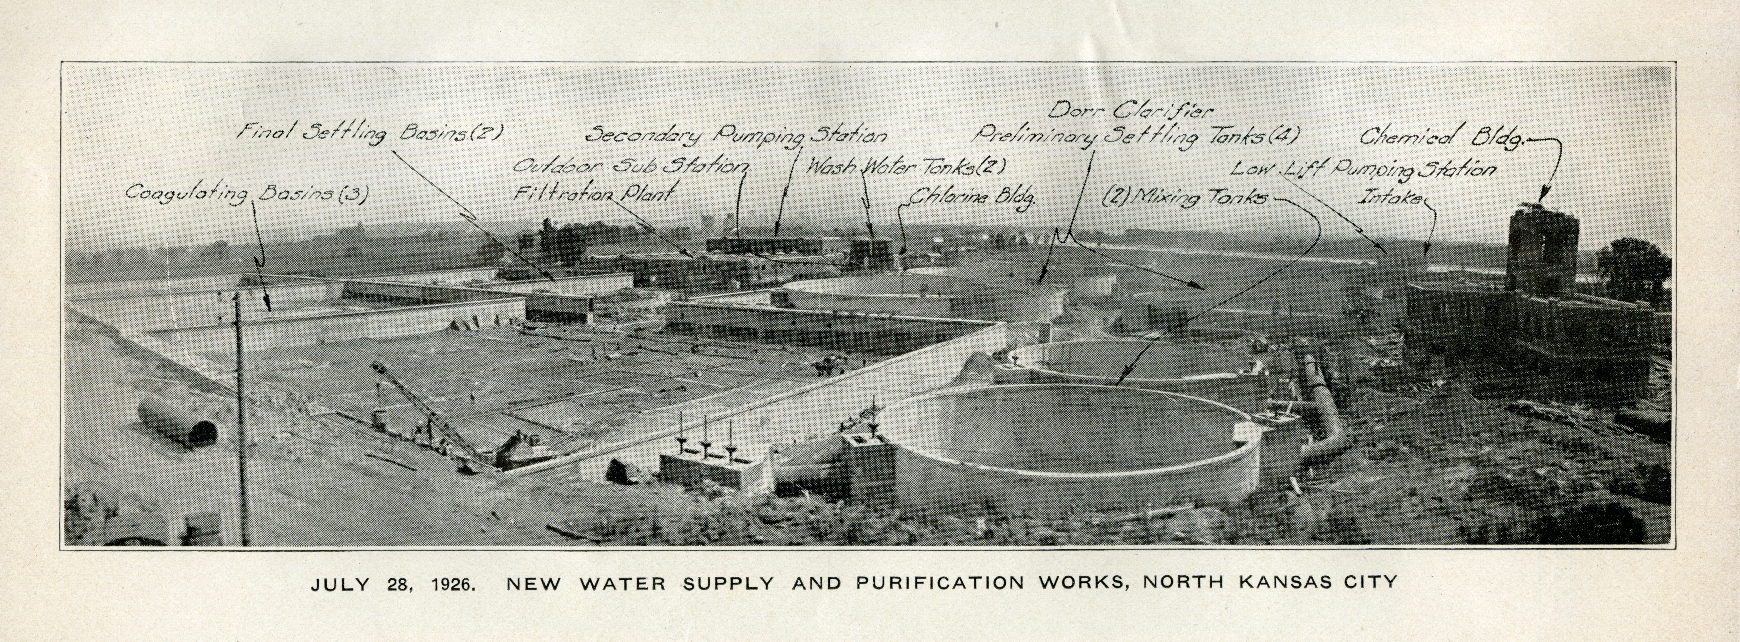
KC Water – Engineering & Facilities

Slide 7
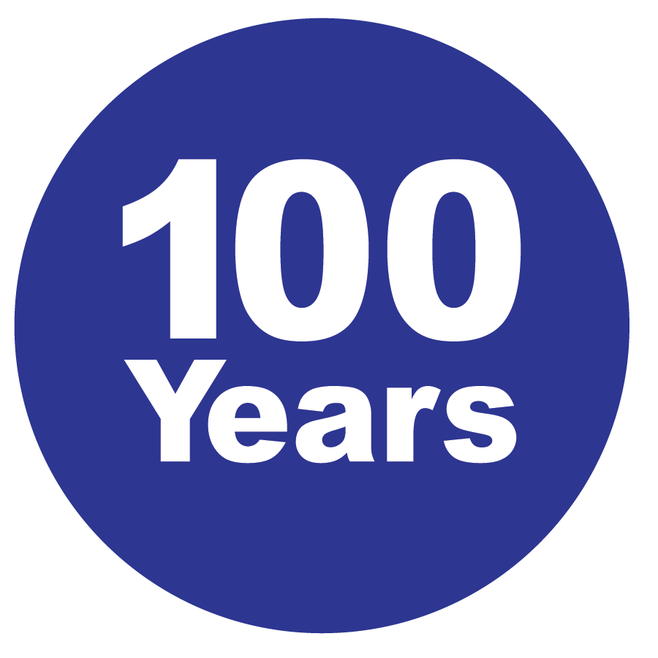

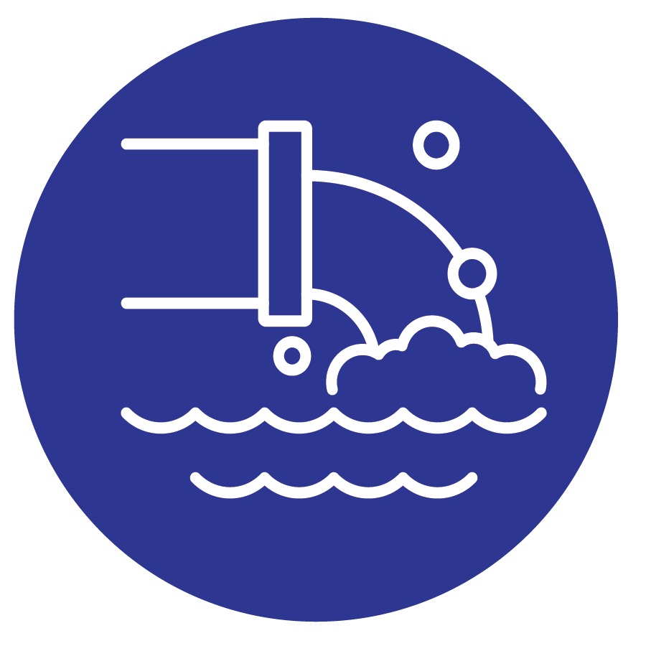

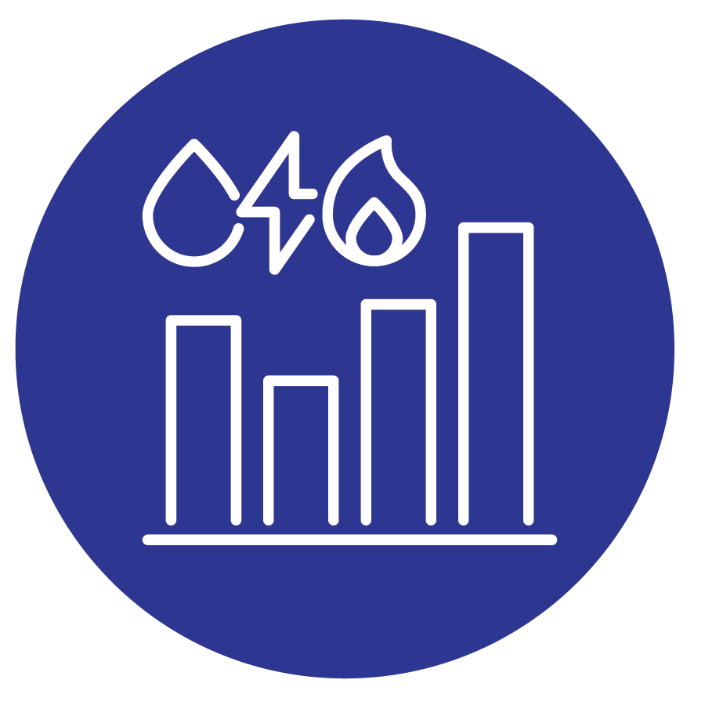
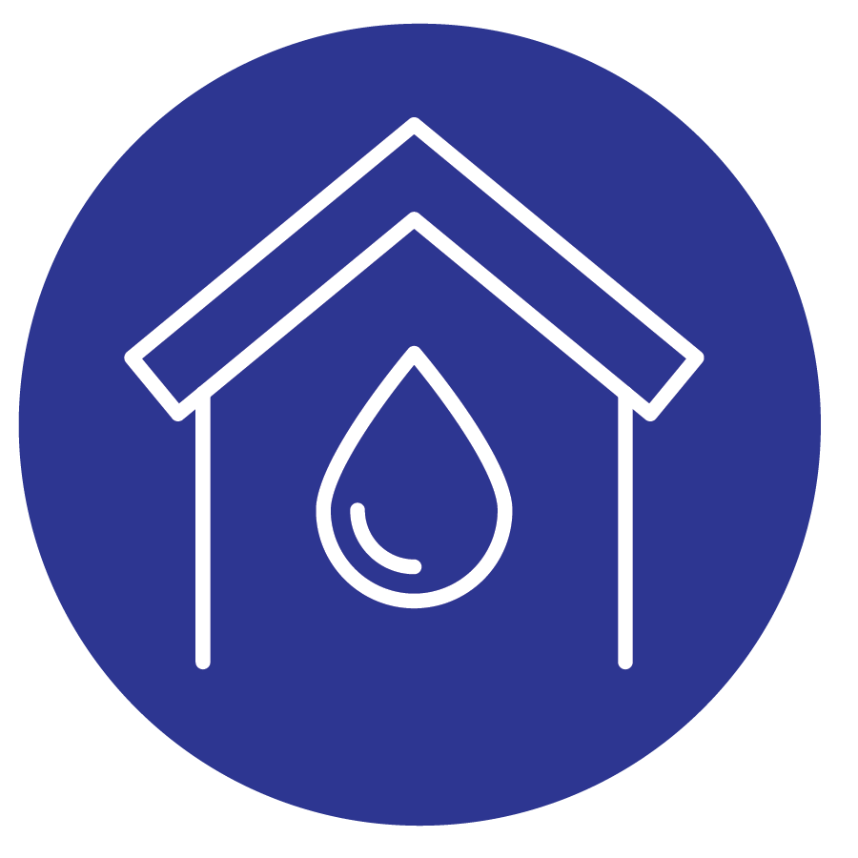

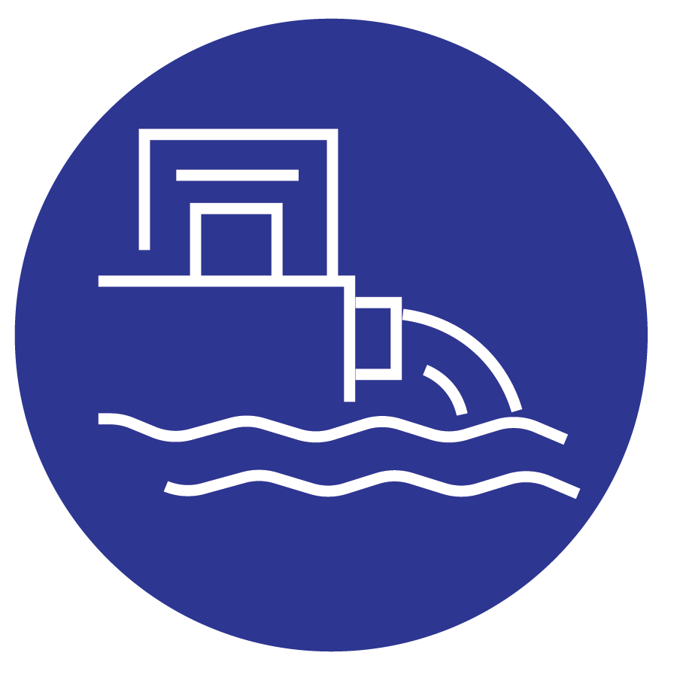
Why explore building a new treatment plant?
KC Water – Engineering & Facilities
The current plant is approximately 100 years old
Maintaining the old facilities requires
expensive specialized contracts
The City needs a more resilient water supply system with improved water quality
KCMO is one of the only cities its size with one water treatment plant
There are no reliable, large interconnections with other metro utilities
Existing plant site has space and height constraints for new technology, processes and future expansion.
Loss of water service could cost region over $100M/day according to FEMA economic valuation
New treatment technologies are more robust for emerging contaminants

Slide 8

KC Water – Engineering & Facilities
Project Drivers
Provide redundant water source reliability
Utilize modern treatment technologies to optimize chemical usage
Build resilient infrastructure
Utilize emerging technologies to potentially remove new contaminants
Reduce risk of water supply shutdowns due to point source operational risks
Reduce current operations and Maintenance costs with maintaining existing systems in limited space and structures

Slide 9
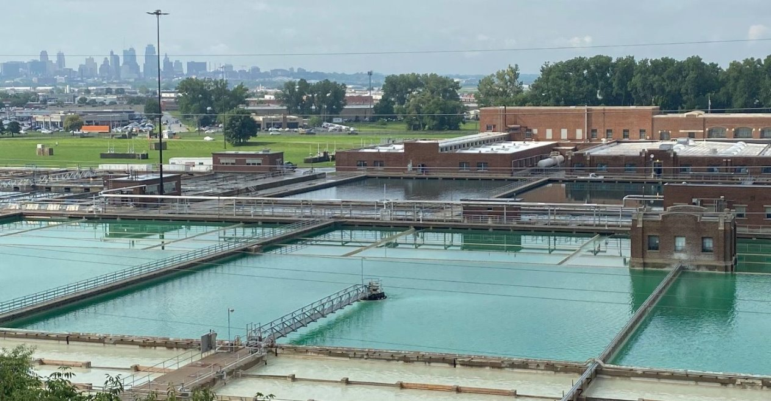
Project Benefits:
KC Water – Engineering & Facilities
Furthers resiliency of overall water supply
Enables Briarcliff WTP to run at lower capacity/shutdown for upgrades and repairs
Gives operational flexibility to:
Provide service south of MO River from second WTP
Provide service north of MO River from Briarcliff WTP
Operate one plant as a base load plant and one plant as peak load plant

Slide 10
Project Support
KC Water – Engineering & Facilities
Integrated Management Planning: Mayoral appointed committee of community leaders came together to help with KC Water’s integrated planning process to guide future water infrastructure decisions.
Group came to the conclusion that constructing a new drinking water treatment plant to improve the reliability and redundancy of Kansas City's drinking water supply as a top priority.
"Drinking water quality and supply redundancy are the most important Water utility priorities. "
Kansas City Industrial Council (KCIC) has made this project their top priority
Missouri and Associated Rivers Coalition (MOARC) supports this as a high priority

Slide 11
Area of Interest – East Bottoms
KC Water – Engineering & Facilities
Proximity to Missouri River – reduces pipeline costs
Proximity to existing infrastructure (i.e. East Bottoms Pump Station, railroads, etc)
= East Bottoms Pump station

Slide 12
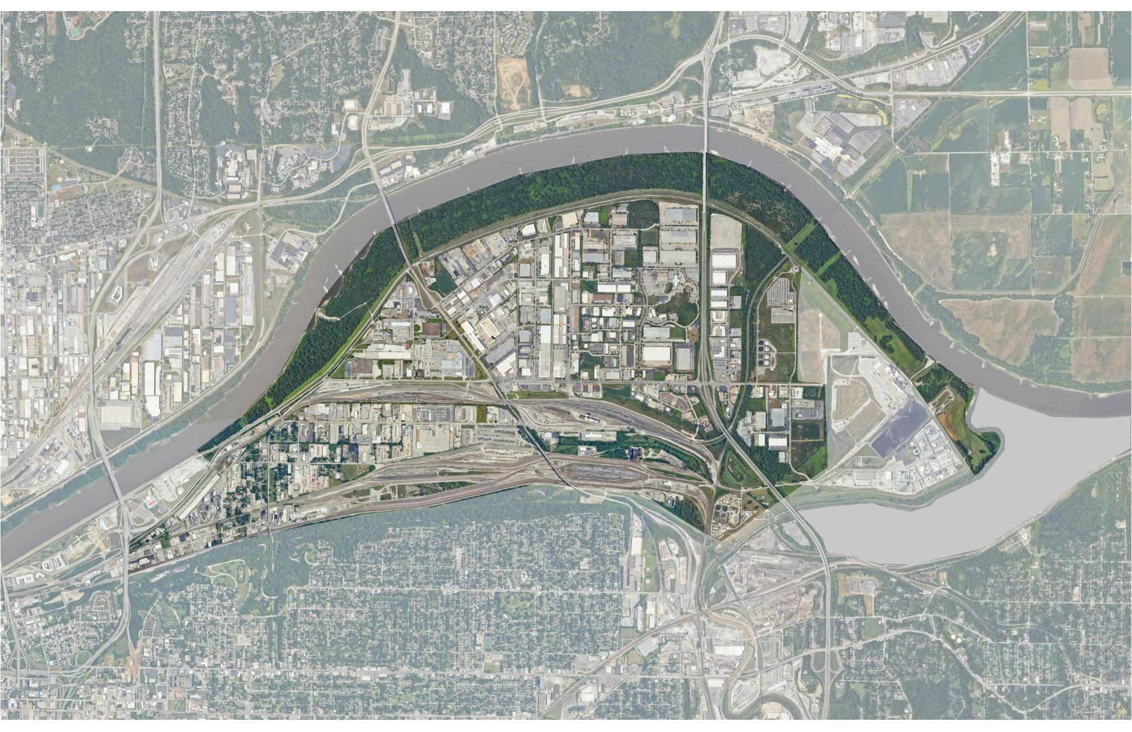
KC Water – Engineering & Facilities
Site Evaluation
Three sites selected for detailed evaluation
Equity considerations
Environmental assessment
Geotechnical evaluation
Groundwater evaluation
Site functionality
Community feedback

Slide 13
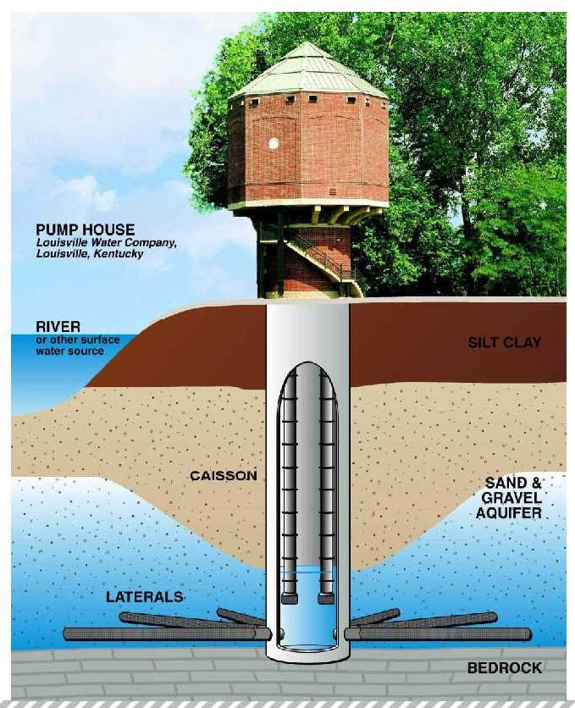
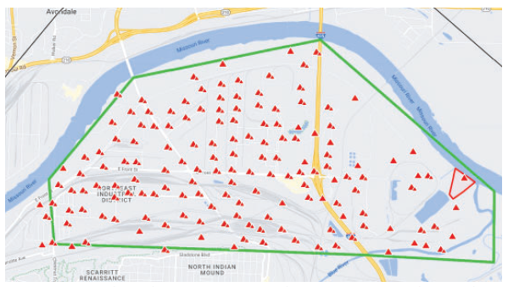
Site Investigations
KC Water – Engineering & Facilities
Utility Surveys
Geotechnical Investigation
Phase I Environmental Investigation
Electrical Load Study
Source Water Study
Rail Access

Slide 14
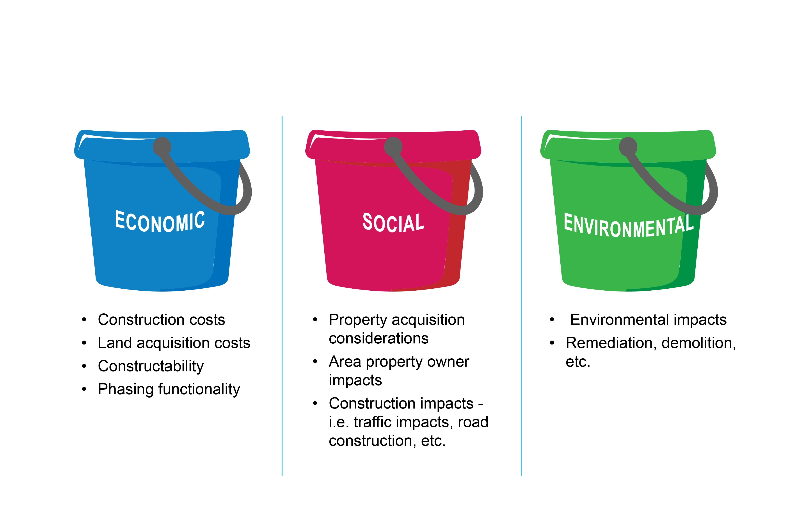
Screening Criteria
KC Water – Engineering & Facilities

Slide 15
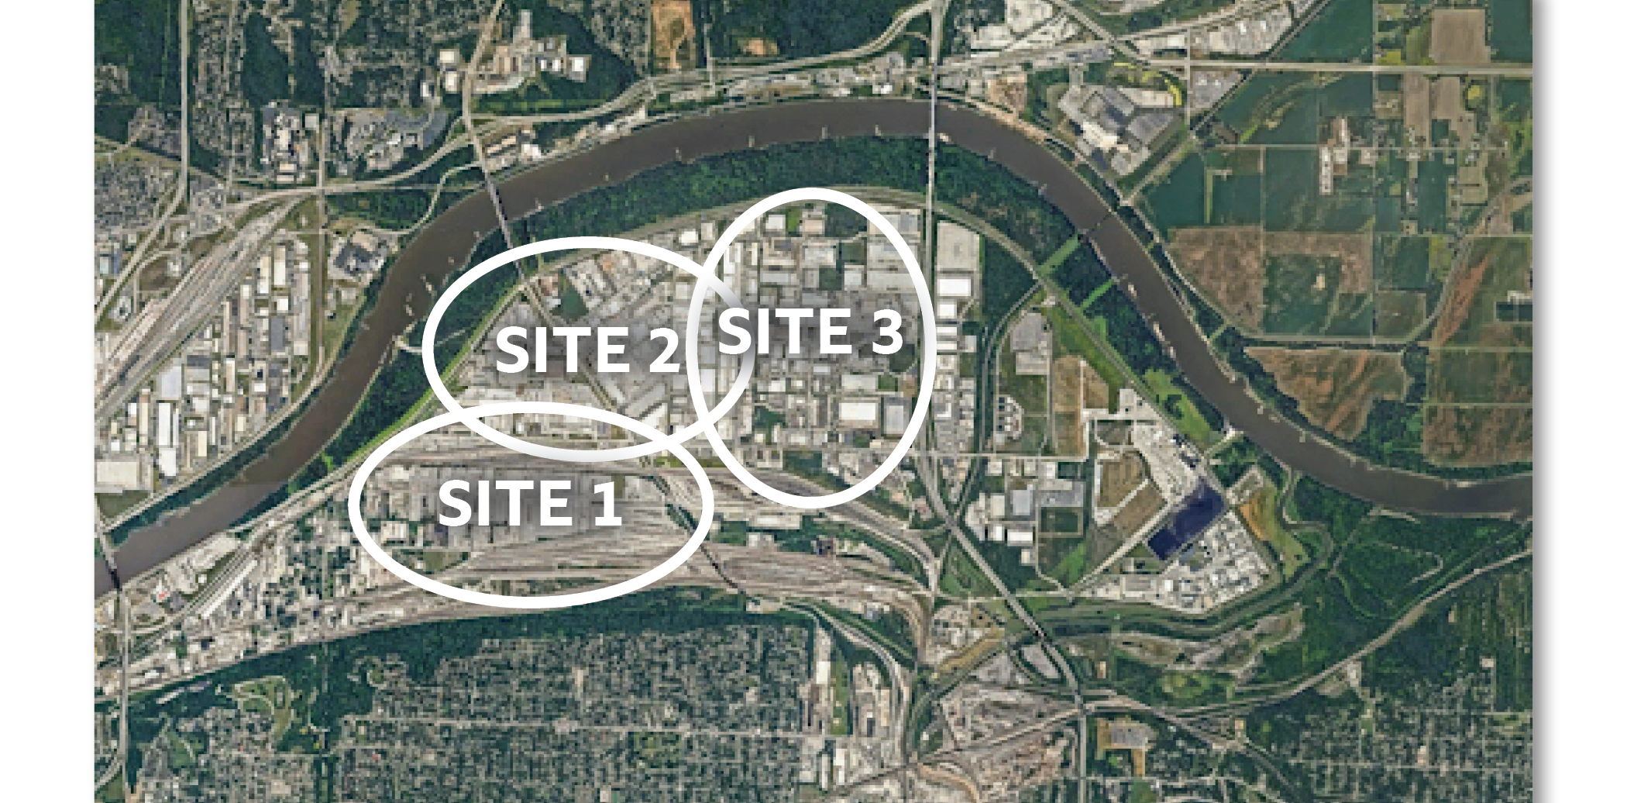
Area of Interest – East Bottoms
KC Water – Engineering & Facilities
= East Bottoms Pump station

Slide 16
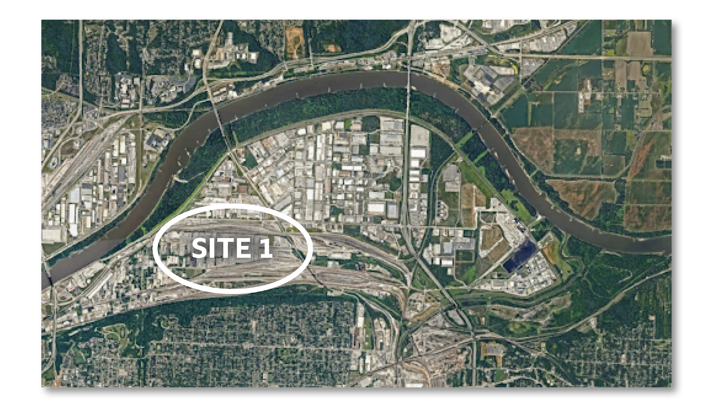
Area of Interest – Site 1
KC Water – Engineering & Facilities
ECONOMIC
Slightly lower capital cost
Good plant layout and phasing functionality
SOCIAL
Most construction and business impacts
Residential properties would be affected
ENVIRONMENTAL
Most properties with environmental issues
= East Bottoms Pump station

Slide 17
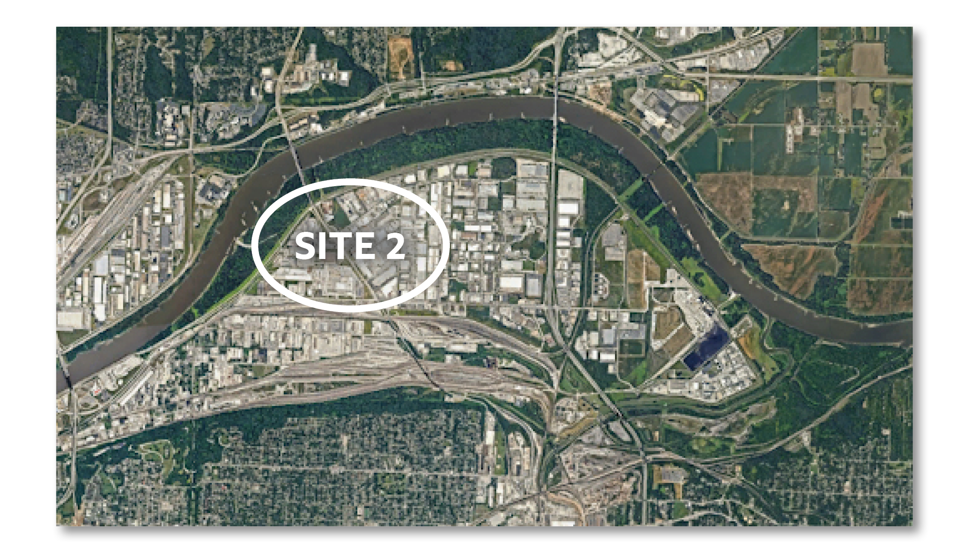
Area of Interest – Site 2
KC Water – Engineering & Facilities
ECONOMIC
Challenges with constructability and phasing
Closer to the Missouri River intake structure
SOCIAL
Significant construction would be required in the levee critical zone
High rail disruption
Moderate level of property owner impacts
No residential properties
ENVIRONMENTAL
Moderate environmental issues
= East Bottoms Pump station

Slide 18
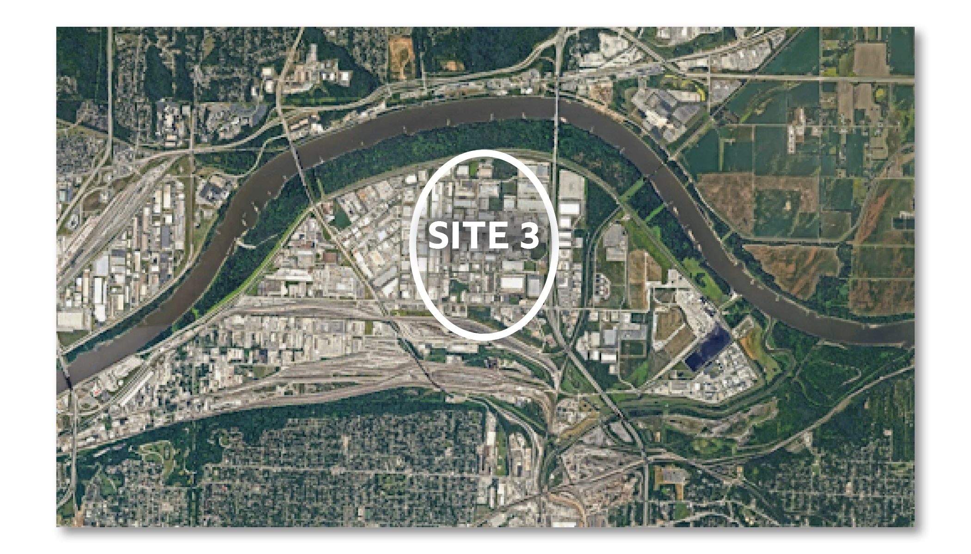
Area of Interest – Site 3
KC Water – Engineering & Facilities
ECONOMIC
Limited utility conflicts
Scored high for constructability and phasing
SOCIAL
Construction outside of levee critical zone
Away from residential area
Scored the highest for the social criteria
Least amount of business impact
No residential properties
ENVIRONMENTAL
Least amount of remediation compared to other sites.
= East Bottoms Pump station

Slide 19
Preferred Site
KC Water – Engineering & Facilities
= East Bottoms Pump station

Slide 20
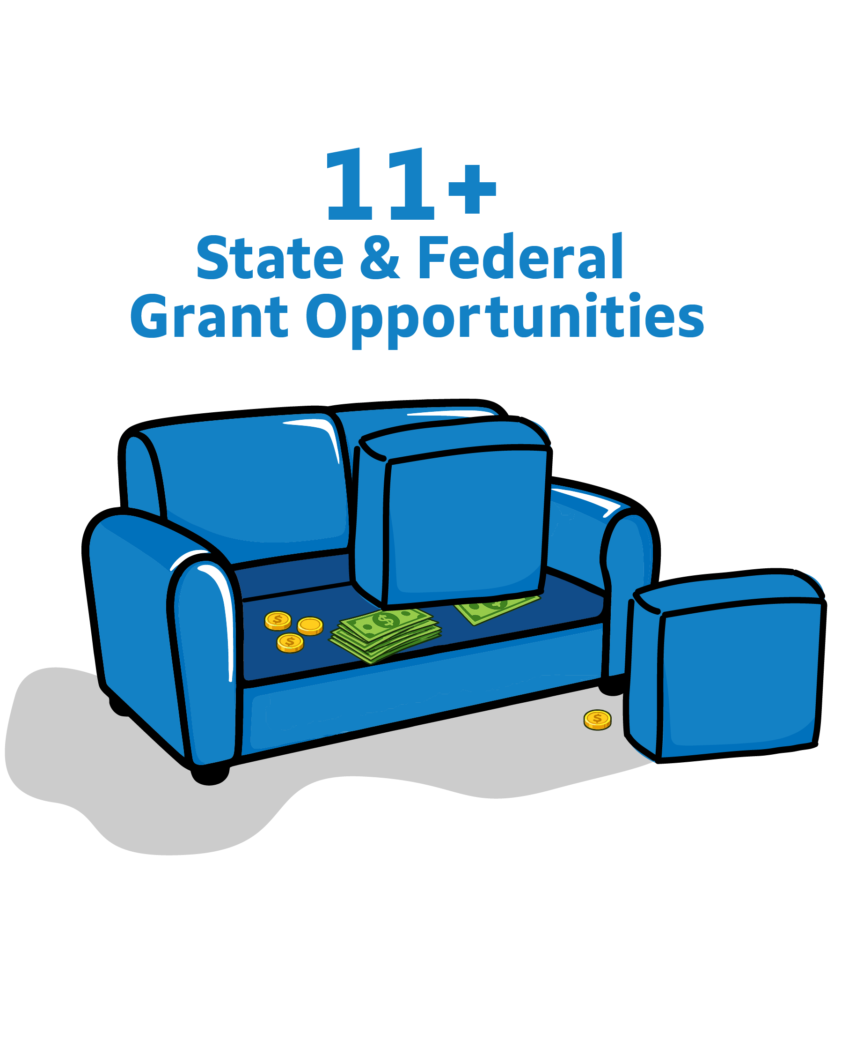
Project Funding
KC Water – Engineering & Facilities
Estimated project timeline: 5 – 10 years
Estimated project cost - $600M - $2B+

Slide 21



Do not edit How to change the design
What questions and input do you have about building a new water treatment plant in the East Bottoms?​
The Slido app must be installed on every computer you’re presenting from

Slide 22
Next Steps
KC Water – Engineering & Facilities
KCIC and MOARC advocacy
Identify grant and funding opportunities
Finalize the site after public input and continue conceptual design

Slide 23

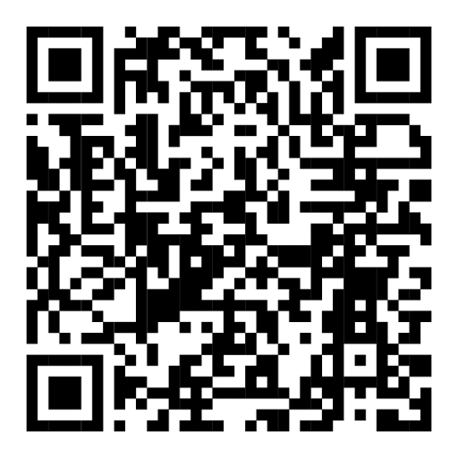


KC Water – Engineering & Facilities
Stay Informed!
http://www.kcwater.us/projects/south-resiliency-water-treatment-plant-project/
(816) 601-0137
alex@parsonkc.com

